Slide 1
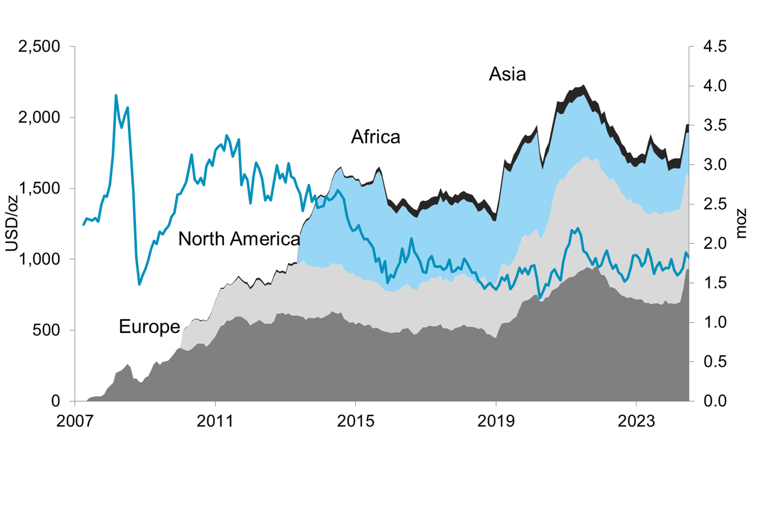
Etf holdings by region
Update: 30-Jun-2024

