Slide 1
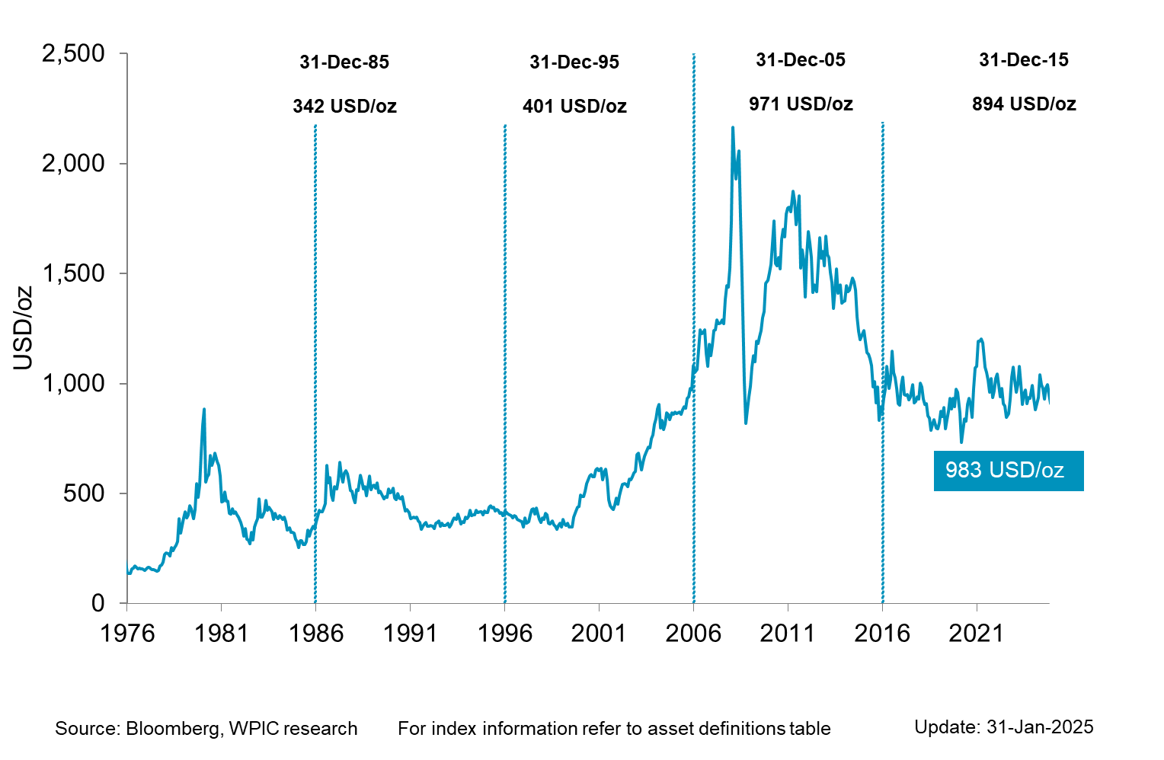
Platinum Price since 1976

