Slide 1
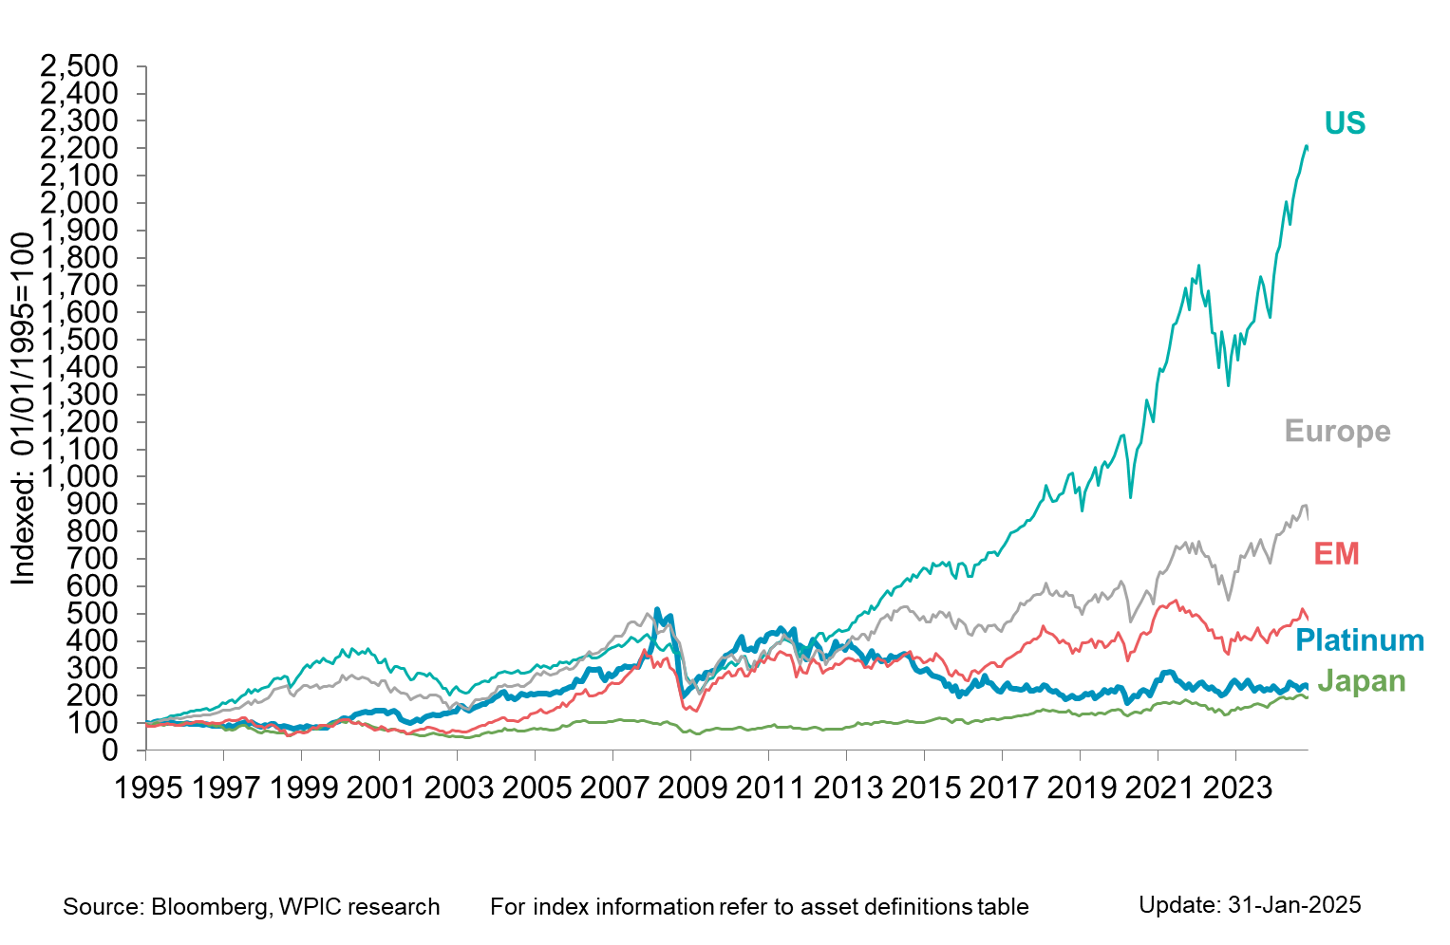
Platinum vs. equities

