Slide 1
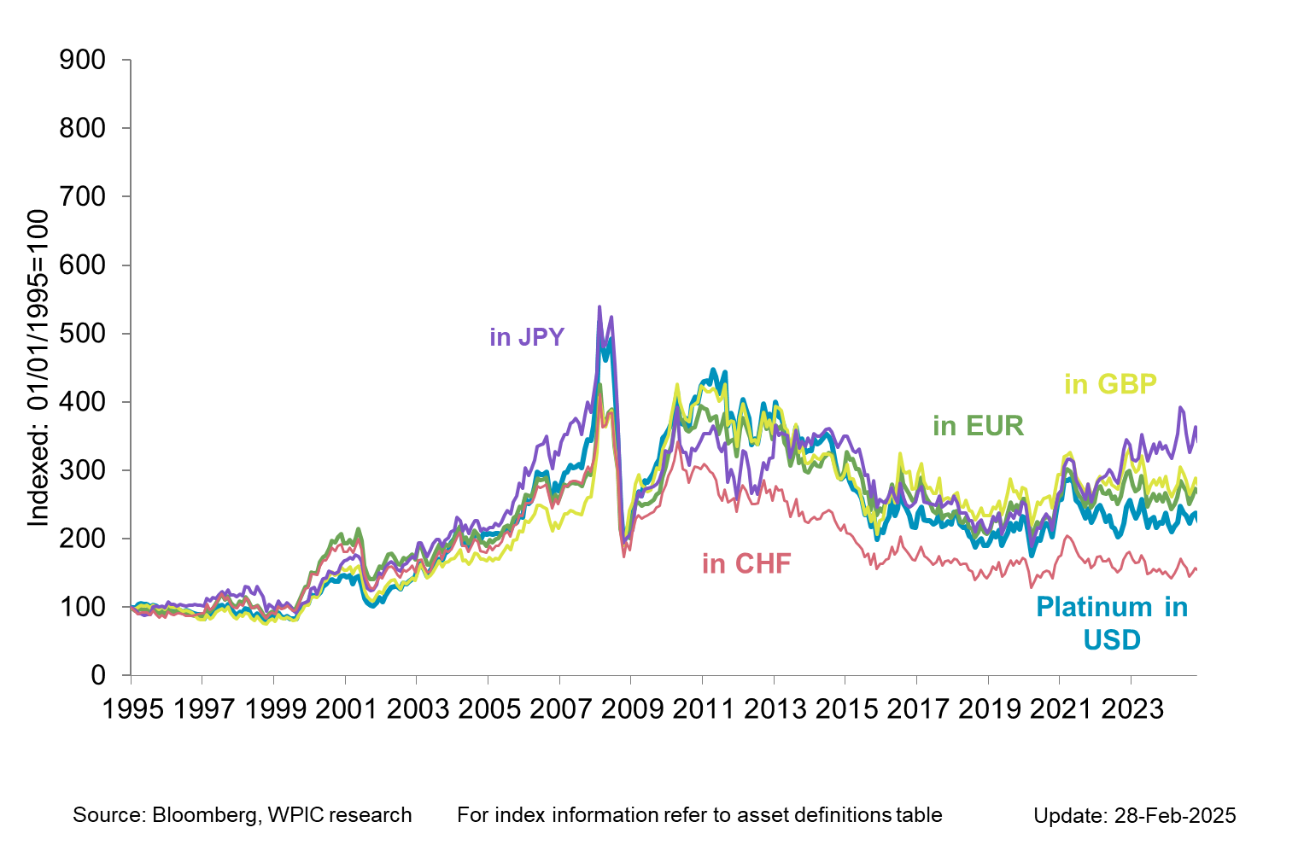
Platinum in key DEVELOPED market currencies

