Slide 1
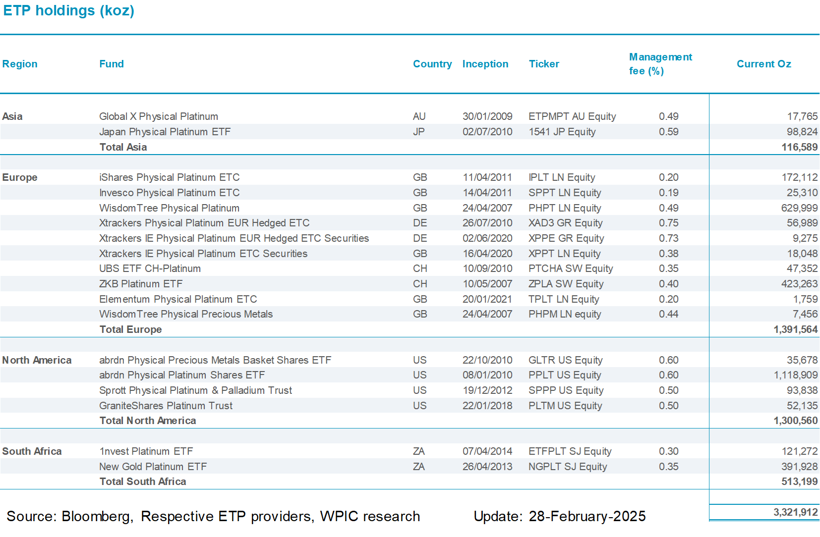

Etf holdings by fund

