Slide 1
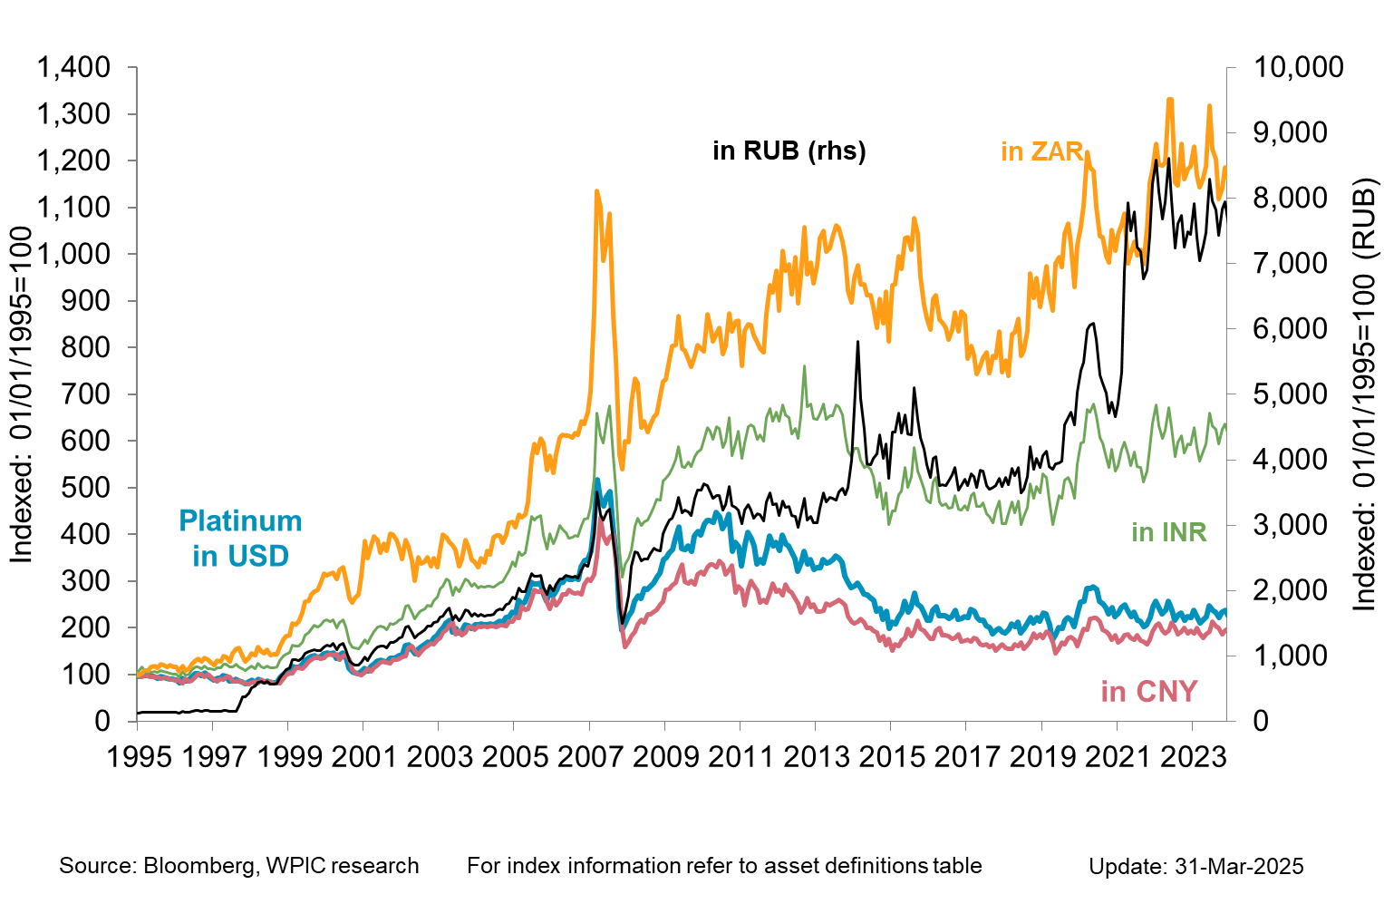
Platinum in key emerging market currencies

