Slide 1
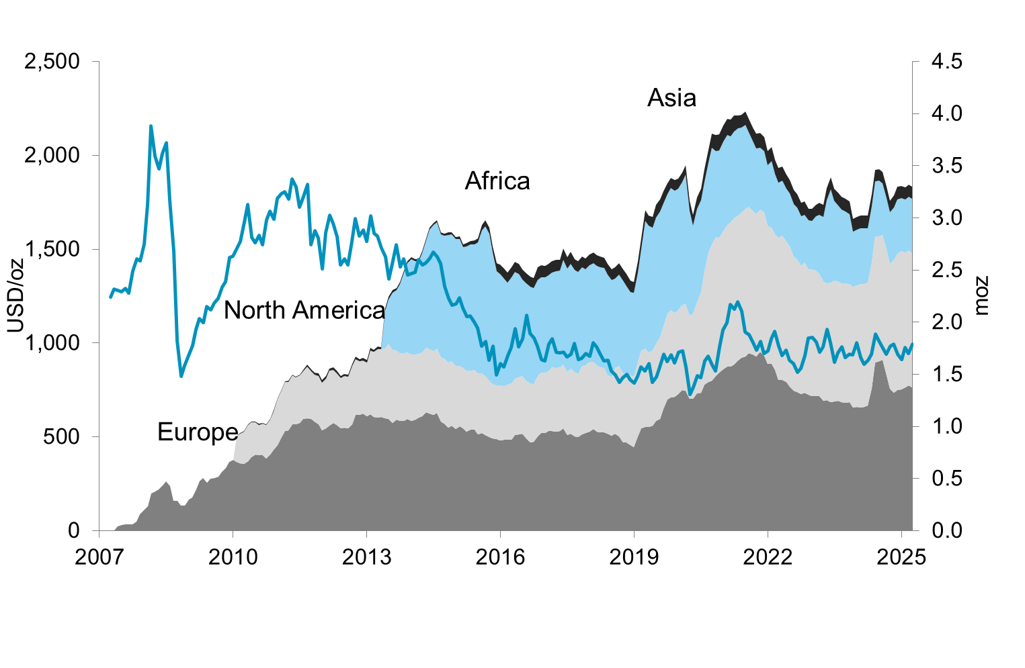
Etf holdings by region
Updated 31-March-2025

