Slide 1
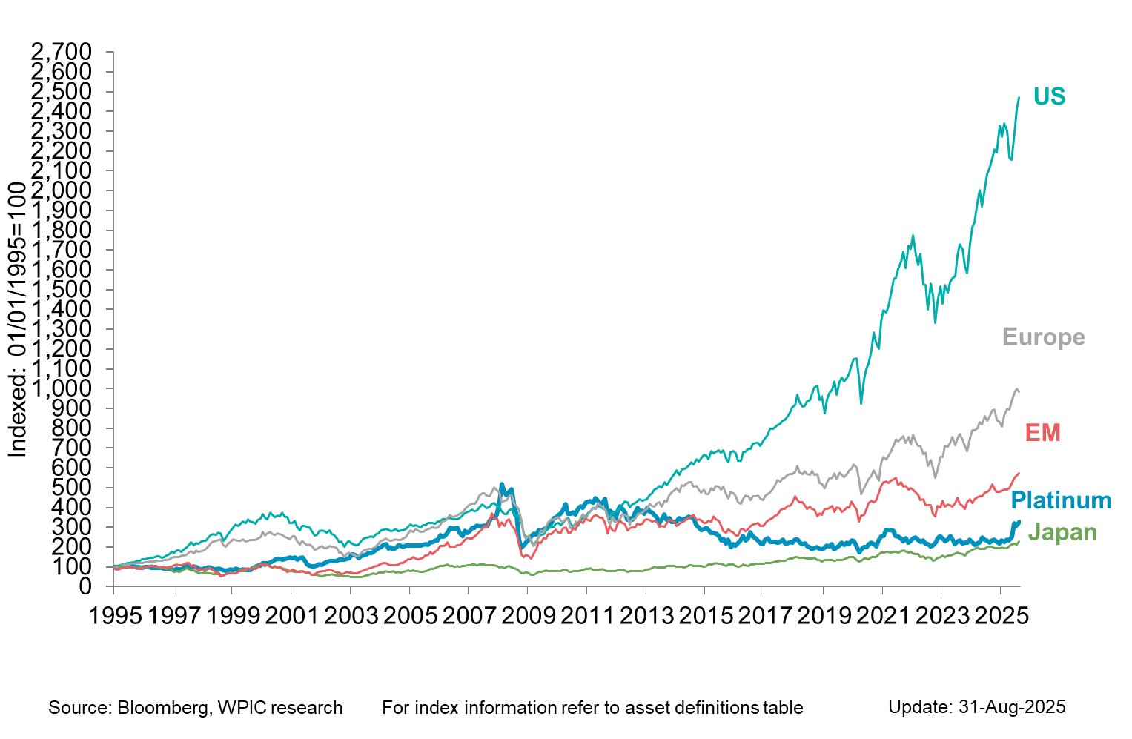

Platinum vs. equities

