Slide 1
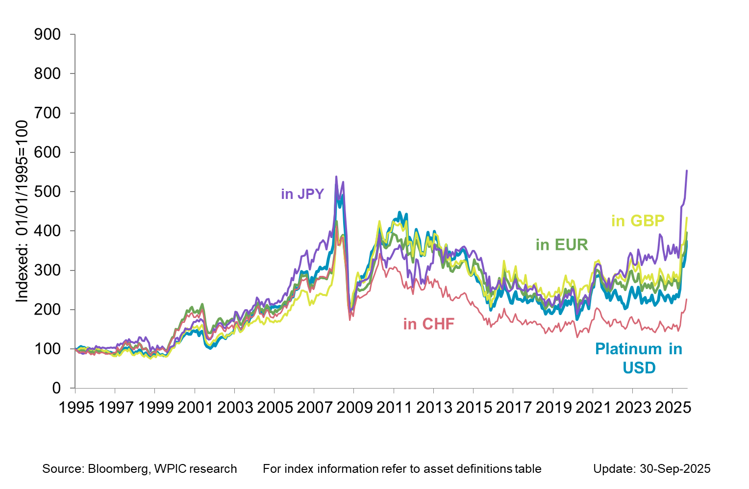

Platinum in key DEVELOPED market currencies

