Slide 1
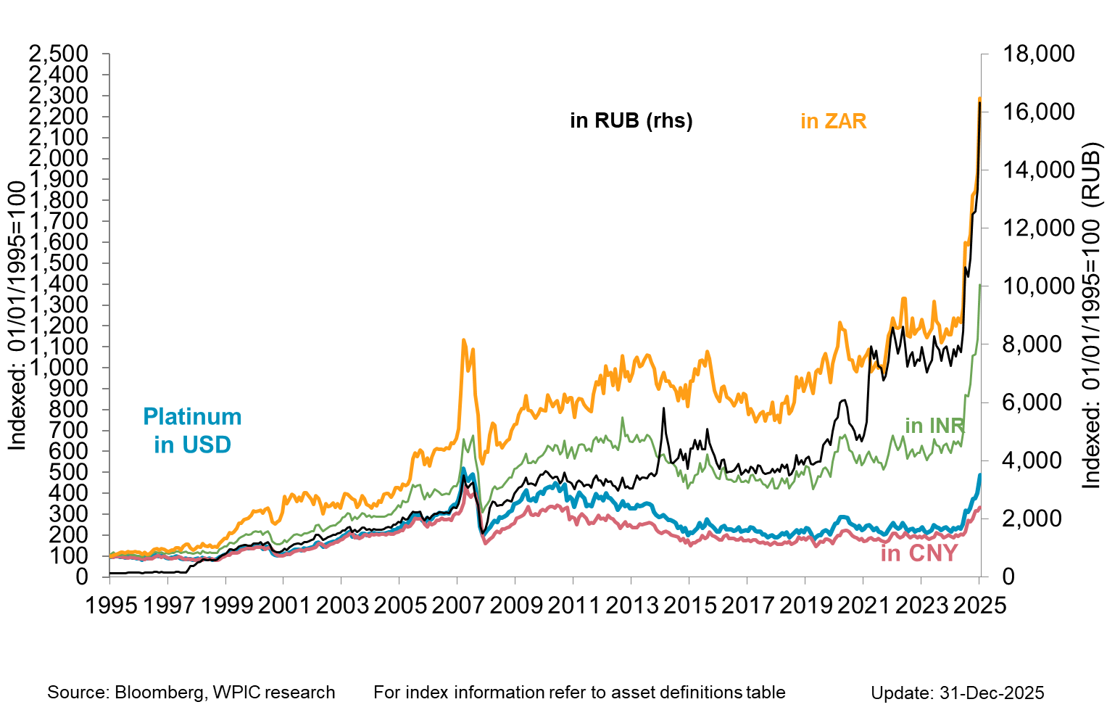

Platinum in key emerging market currencies

