Slide 1
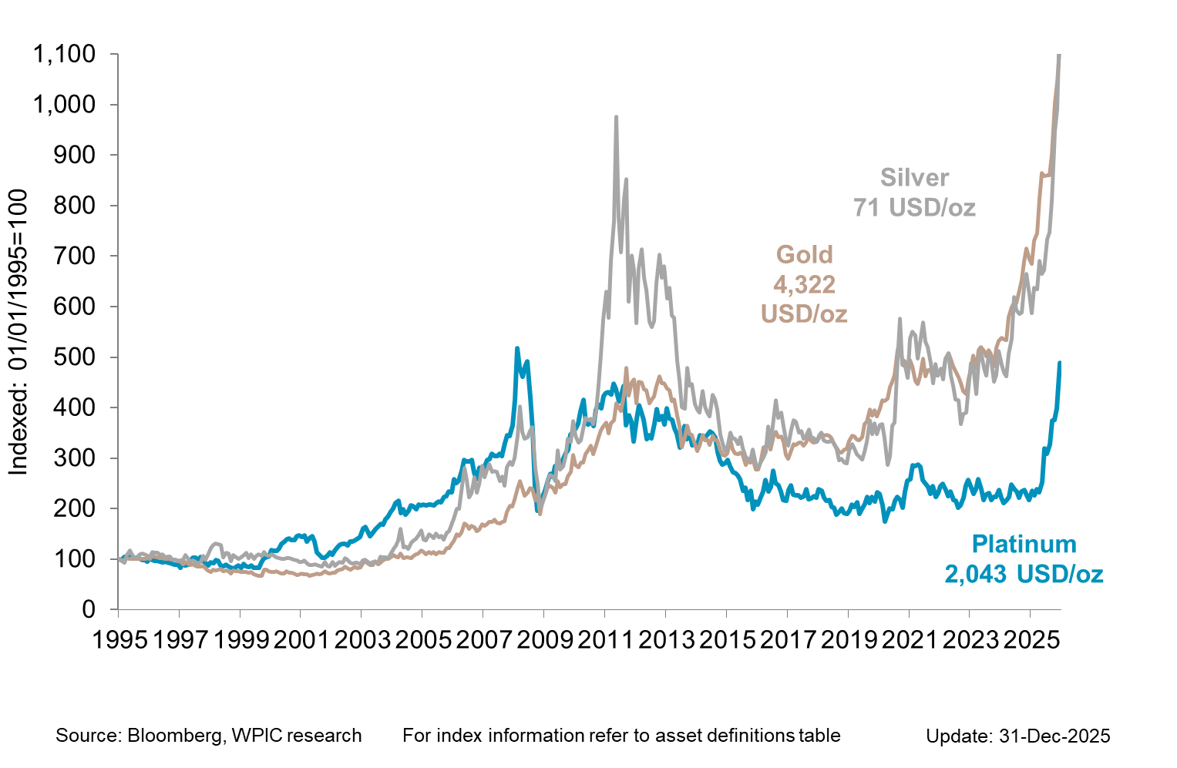

Precious metals performance since 1995

