Slide 1
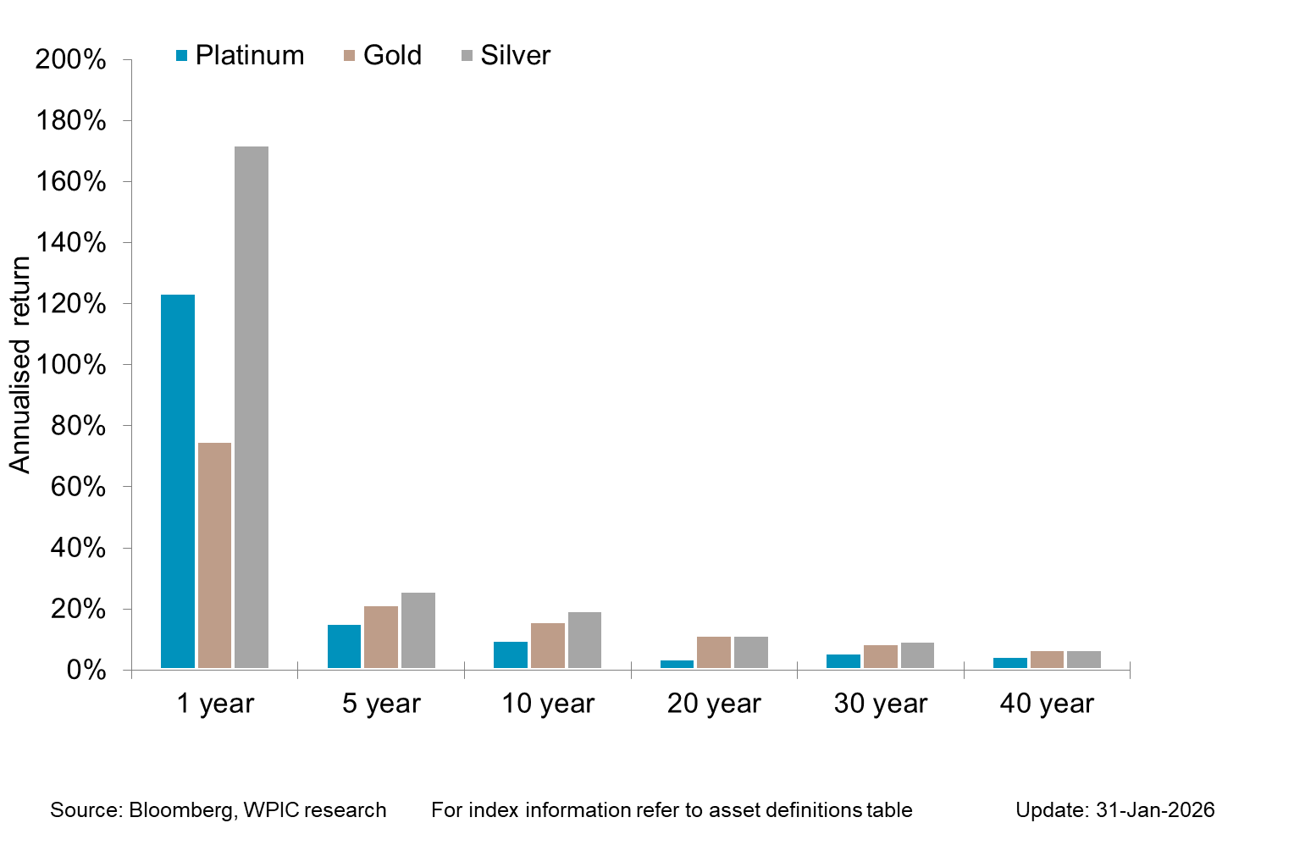

Precious metals price performance over 1-40 year periods

