Slide 1
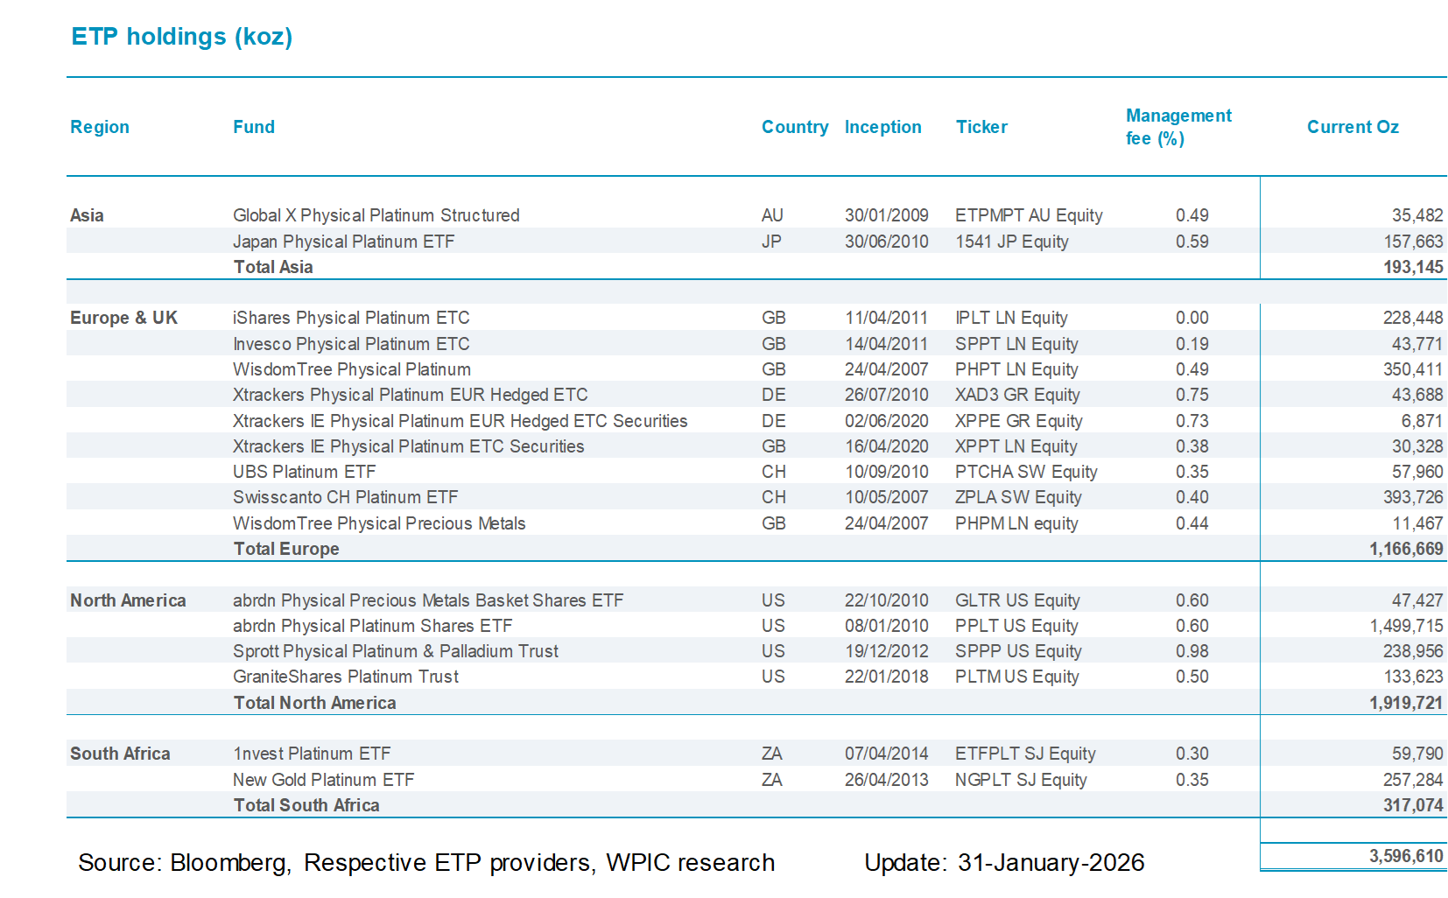

Etf holdings by fund
Source: Bloomberg, Respective ETP providers, WPIC research Update: 30-April-2025
Source: Bloomberg, Respective ETP providers, WPIC research Update: 31-March-2025
Source: Bloomberg, Respective ETP providers, WPIC research Update: 31-May-2025

