Slide 1
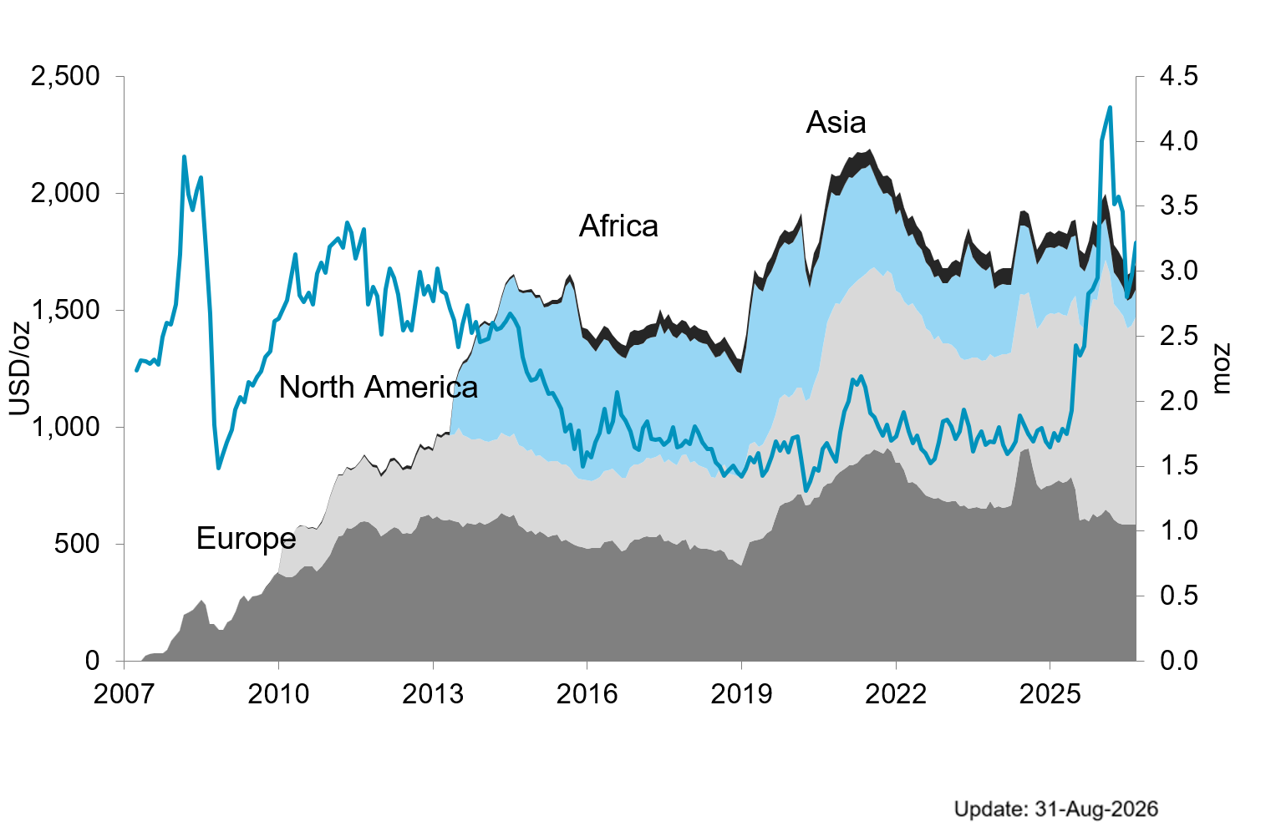

Etf holdings by region

