Slide 1
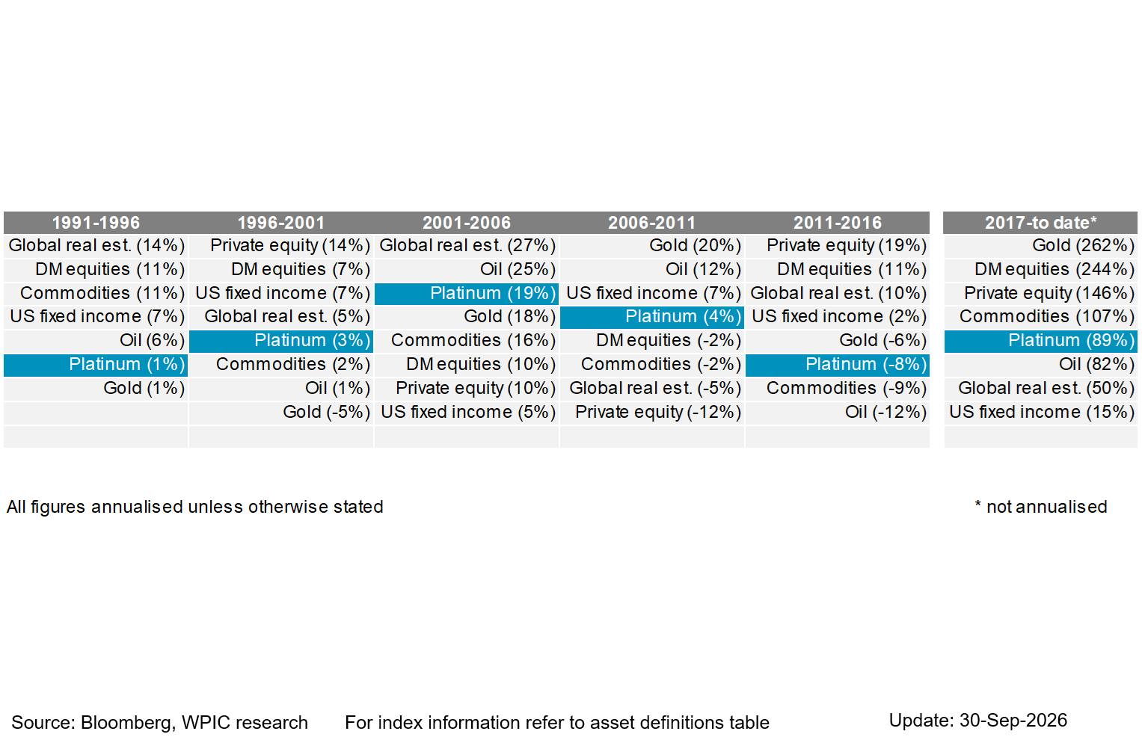

Platinum vs. various asset over 5-year windows, annualised returns

