Slide 1
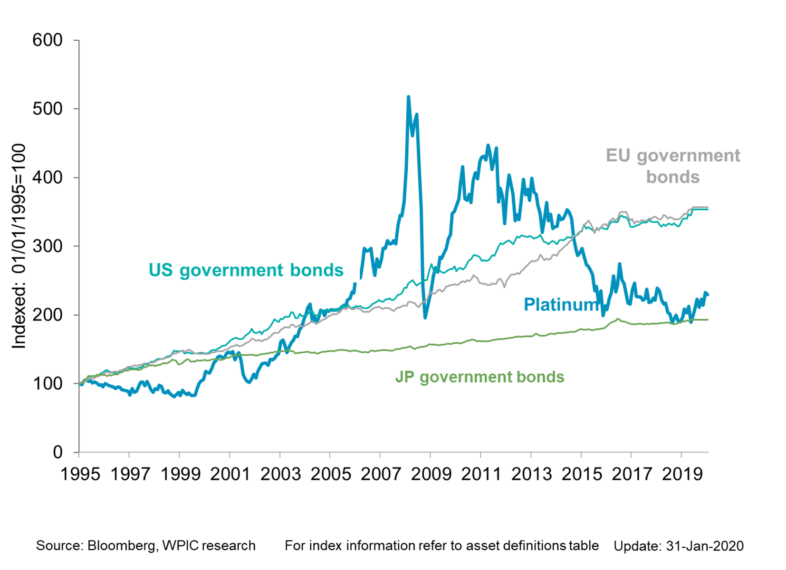
Platinum vs. bonds

