Slide 1
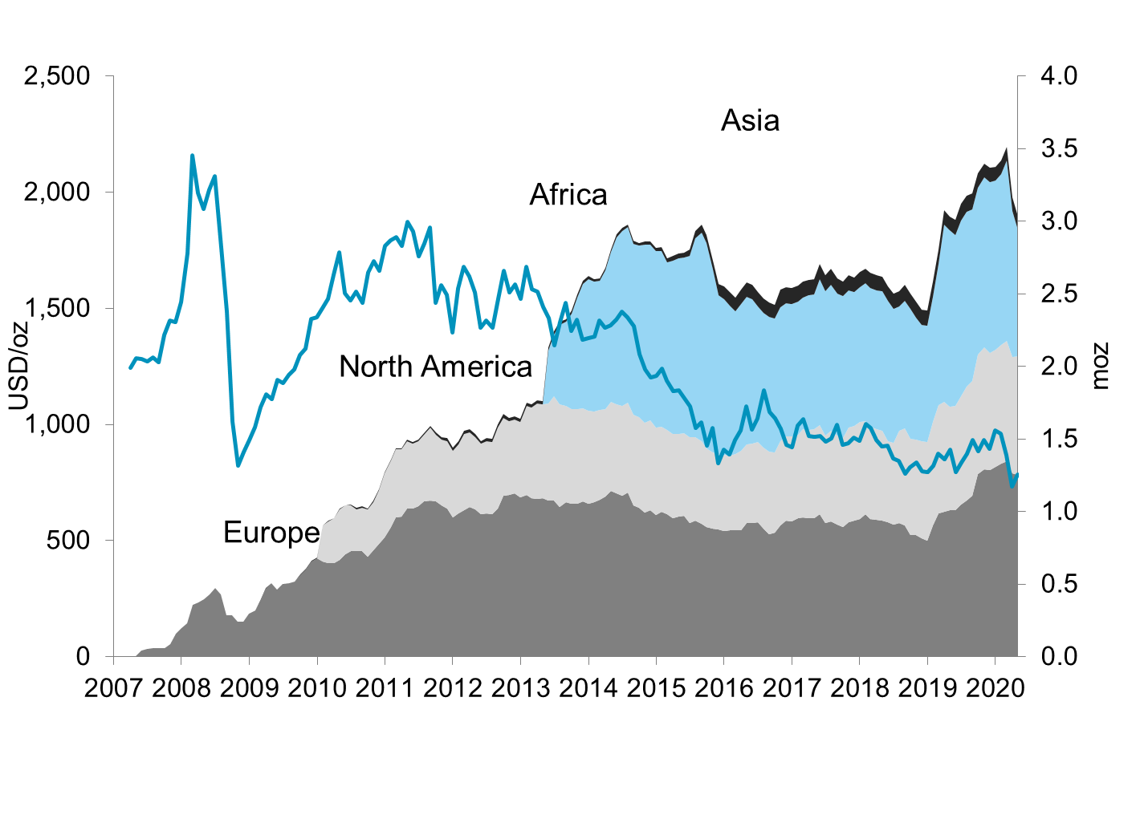
Etf holdings by region
Update: 30-April-2020

