Slide 1
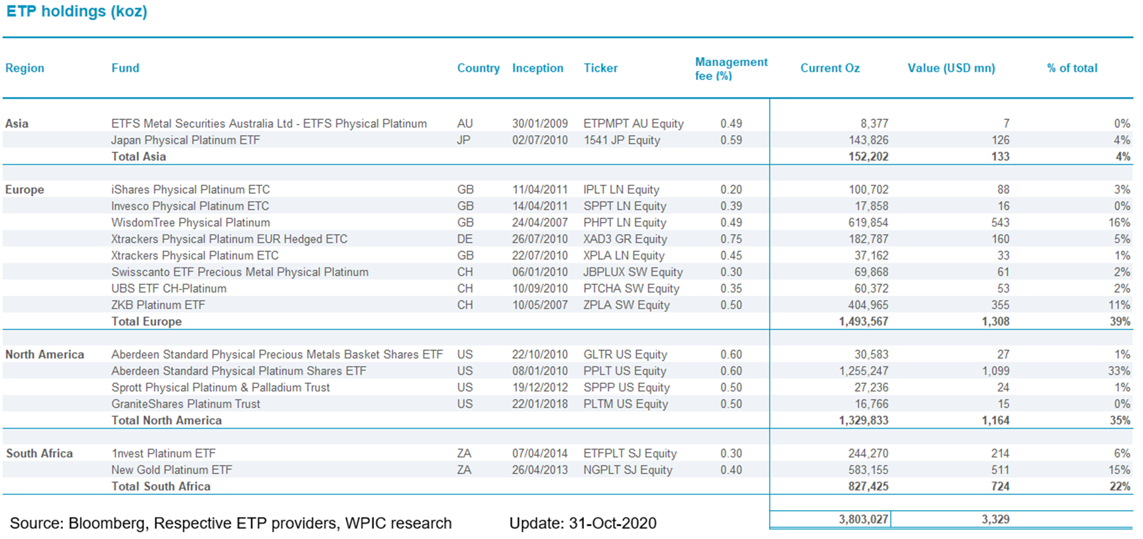
Etf holdings by fund

