Slide 1
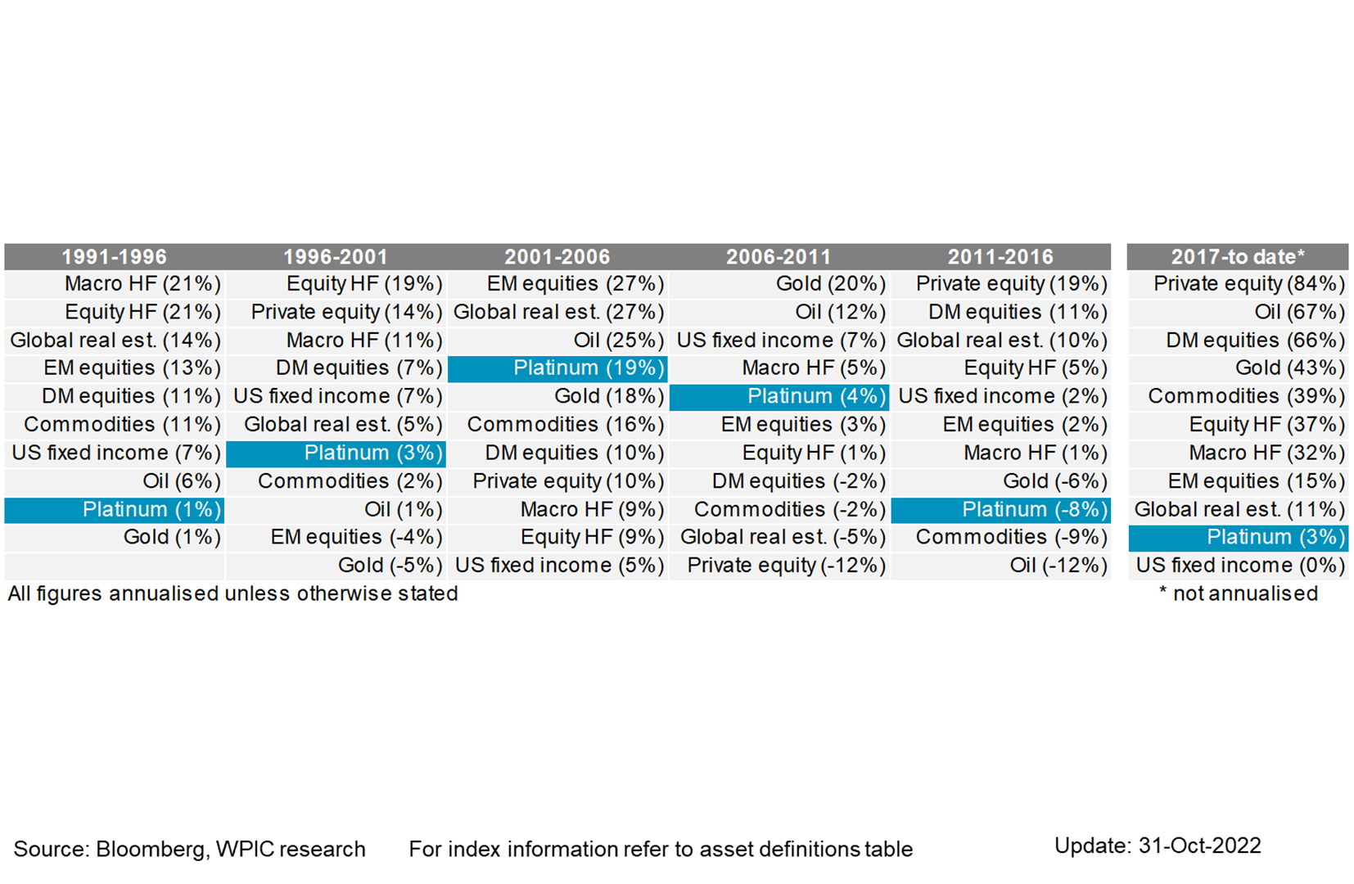
Platinum vs. various asset over 5-year windows, annualised returns

