Slide 1
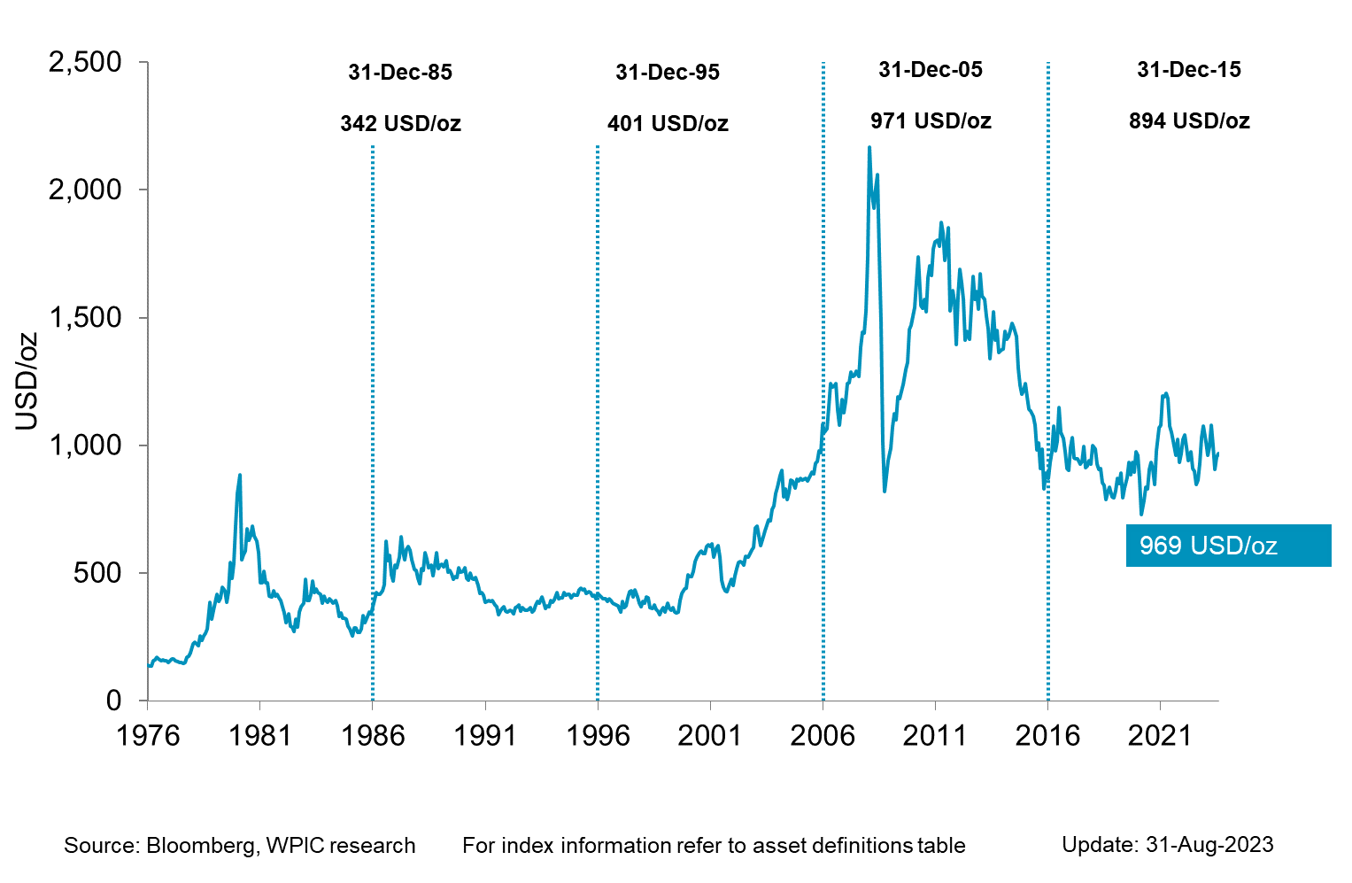

Platinum Price since 1976

