Slide 1
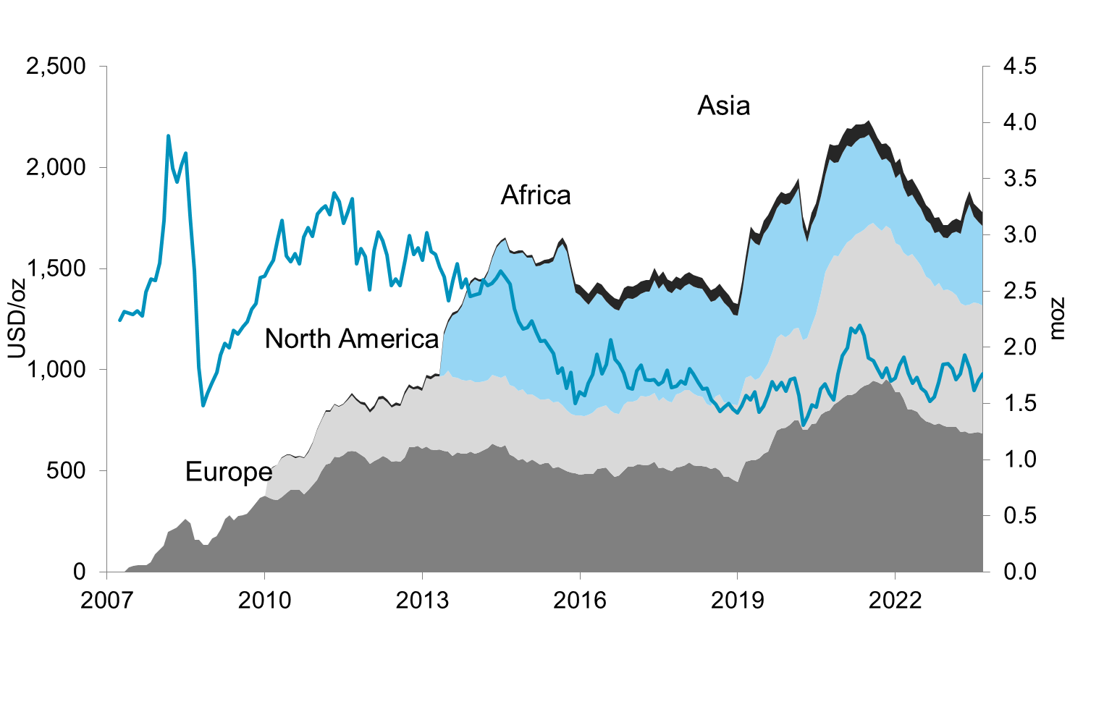
Etf holdings by region
Update: 31-Aug-2023

